Slide 1


Presentation of the project
“Job Seeker App”
We use tech to connect human potential and opportunity with dignity & humility
Name: Shelikhov Dmytro
Contact: shelikhovdmytro@gmail.com

Slide 2




Pros of the App
Describe and show the App
Plans for the future
Plan of the presentation

Slide 3




Pros of the App
My website is a smart application that gives you all the possible vacancies that you want to see using certain filters. My bot searches for vacancies on some of the most popular websites like Linkedin, Stepstone and Indeed.
My APP makes job searching easier and faster

Slide 4


Pros of the bot
In my opinion, my bot has a lot of proses:
Easy to use
Automatically retrieve and collect all possible vacancies using specific filters from 3 websites
Extensibility(I can easily add new features in my App)
Convenient output data format with Excel file
Quick job search

Slide 5

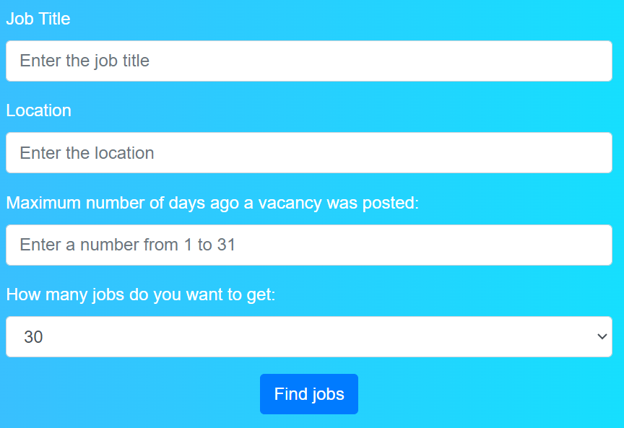
Describe and show the bot
With my App people can quickly and efficiently search for jobs that interest them with certain filters(Job title, Location, Maximum number of days ago a vacancy was posted, How many jobs do you want to get)

Slide 6
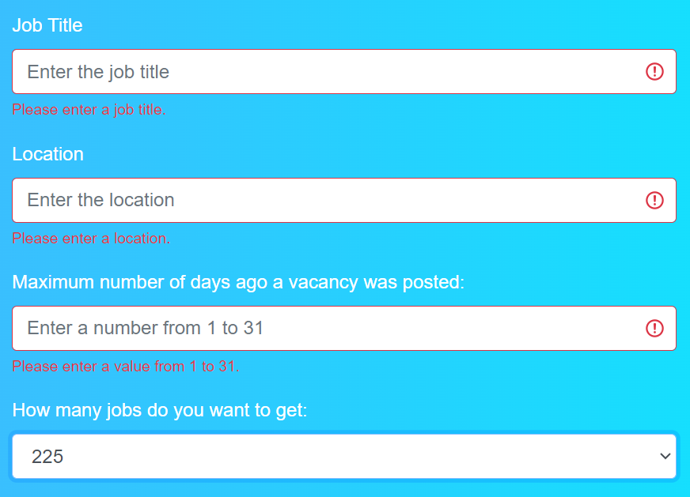

Describe and show the bot
My application has a time limit for posting a job (maximum 31 days, minimum 1), you can also find only 225 vacancies and you cannot leave the fields empty, otherwise it will throw an error.

Slide 7
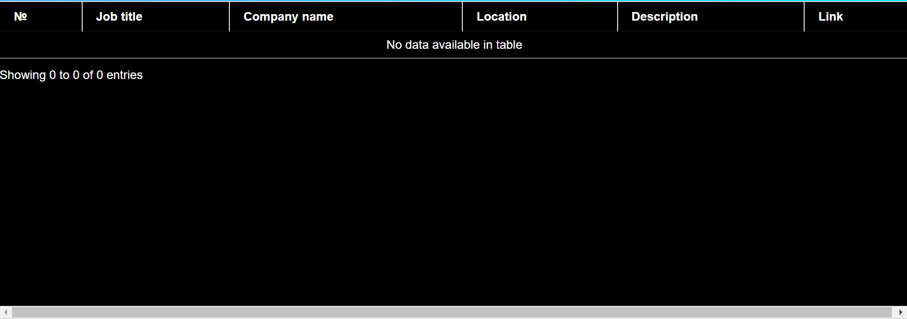
Describe and show the bot
if fewer vacancies are found than you set, my application will display all possible, if no vacancies were found at all, it will display an empty file.

Slide 8
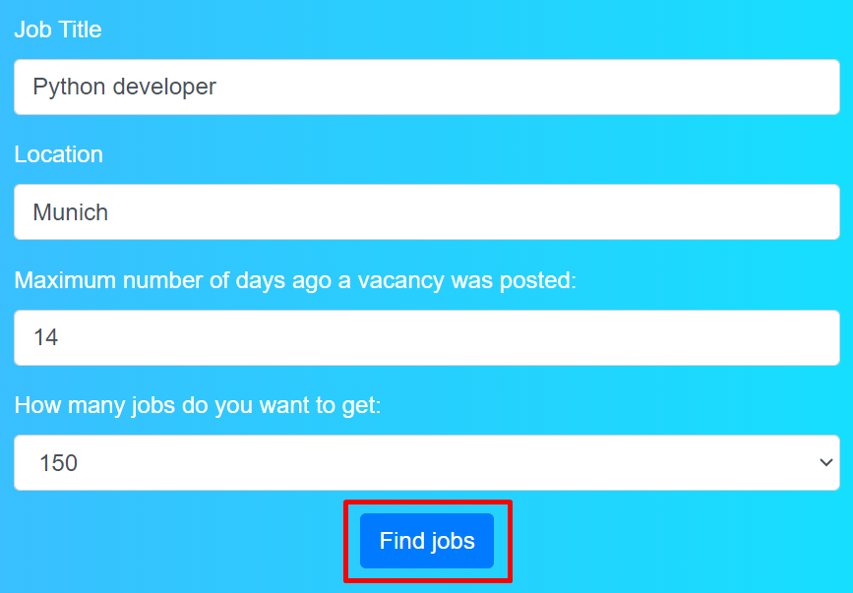
Describe and show the bot
After entering all the filters, you need to click on the button ‘Find jobs’ and my program will begin searching for vacancies and generation Excel file.

Slide 9
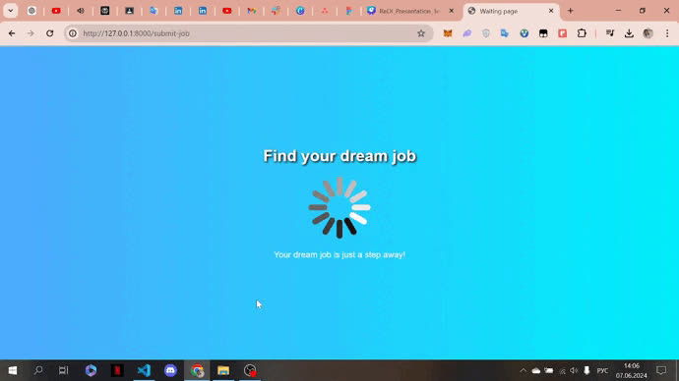
Describe and show the bot
After clicking on the button, the user will be redirected to a waiting page while the program receives data from websites with jobs (on average this takes from 45 seconds to 2 minutes).

Slide 10
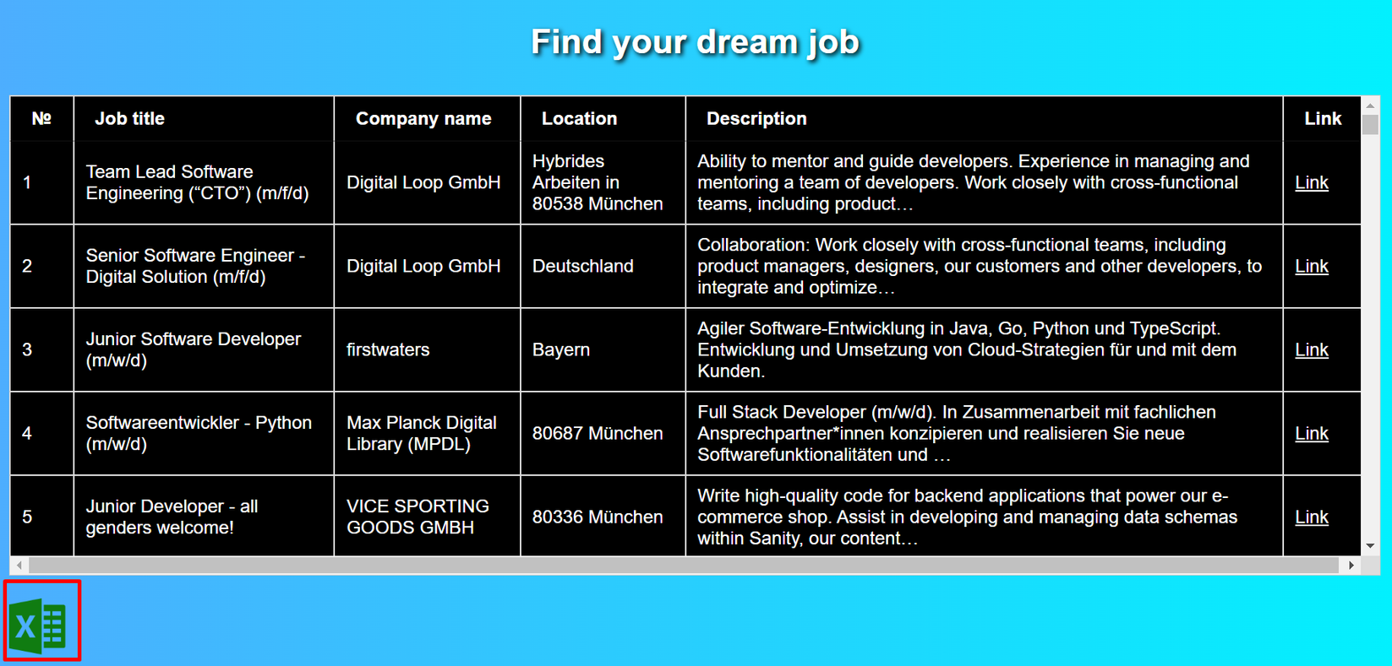
Describe and show the bot
After the program finds and processes all vacancies, they will be displayed in the form of a table and can be downloaded below in an Excel file.

Slide 11
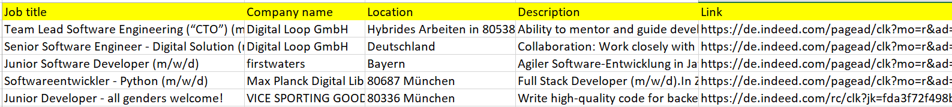
Describe and show the bot
The final file consists of fields such as Job title, Company name, Location, Description, Link to this job.

Slide 12
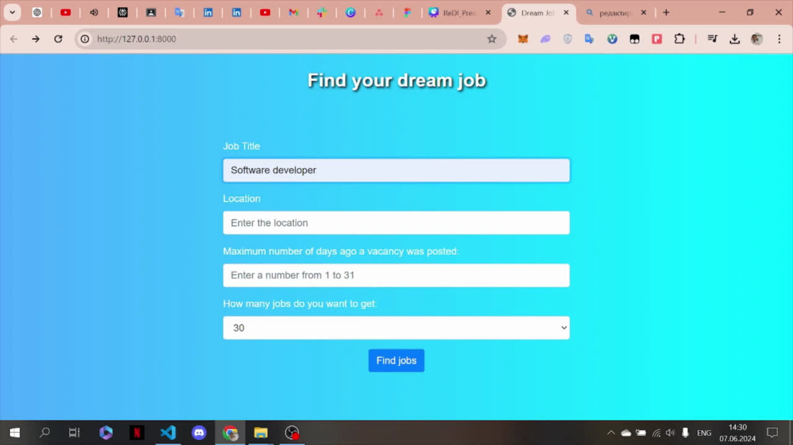
Describe and show the bot
Now I want to show how it works.

Slide 13
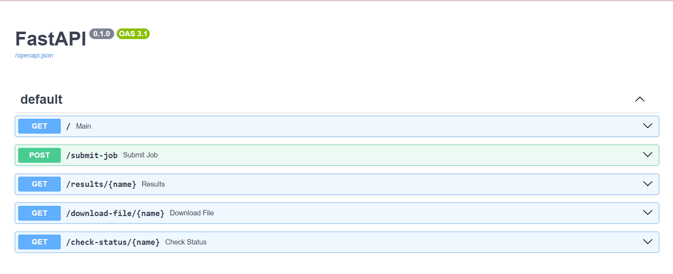
All Api of my App

Slide 14
Plans for the future
Make job search faster
Support for multiple languages
Adding new job search sites
Adding new functionality
Adding new filters
Change waiting page
Many other things

Slide 15



Thanks a lot!
Contact
Dmytro Shelikhov
Beginer Backend-Developer
shelikhovdmytro@gmail.com

